Slide 1


Egyptian National E-Learning University
Evaluation System Student
Sohag 2024

Slide 2


Supervised
Team Member
Dr: Ahmad Yaqoub
Lecturer, Department of Information Technology at Egyptian E-Learning University (EELU)
•1-Mohamed Abd Elmoamen Mahmoud
•2-Hossam Mohamed Kamal Eldine.
•3-Mohamed Ahmed Shehata
•4-Ahmed Waheed Abdelhamed
•5-Ali Salah Ali
•6-Ibrahim Abd El khalek ahmed
Eng :Khalid Mohammed
Teacher Assistant, Department of Information Technology at Egyptian E-Learning University (EELU)

Slide 3



Table Of Contents
01
Introducation
02
Literature Review
System analysis and design
03
04
Implementation
05
Future Work
Conclusion
06

Slide 4
Egyptian National E-Learning University
1
INTRODUCTION
Sohag 2024

Slide 5

Introduction
Good evening everyone.
Today, I am excited to introduce our project: the Evaluation System Student. Evaluation is essential in education as it assesses student performance, provides valuable feedback, and helps improve teaching methods. Our project aims to streamline and enhance this process, offering a more accurate and comprehensive system for student evaluation.
Let's explore how our Evaluation System Student can transform the assessment process and improve the educational experience for both students and educators.

Slide 6


Tasks oF Evaluation
Projects and Assignments:
Quizes
01
02
03
04
Improvement and Adaptation:
Surveys and Feedback

Slide 7
Egyptian National E-Learning University
2
Literature Review
Sohag 2024

Slide 8
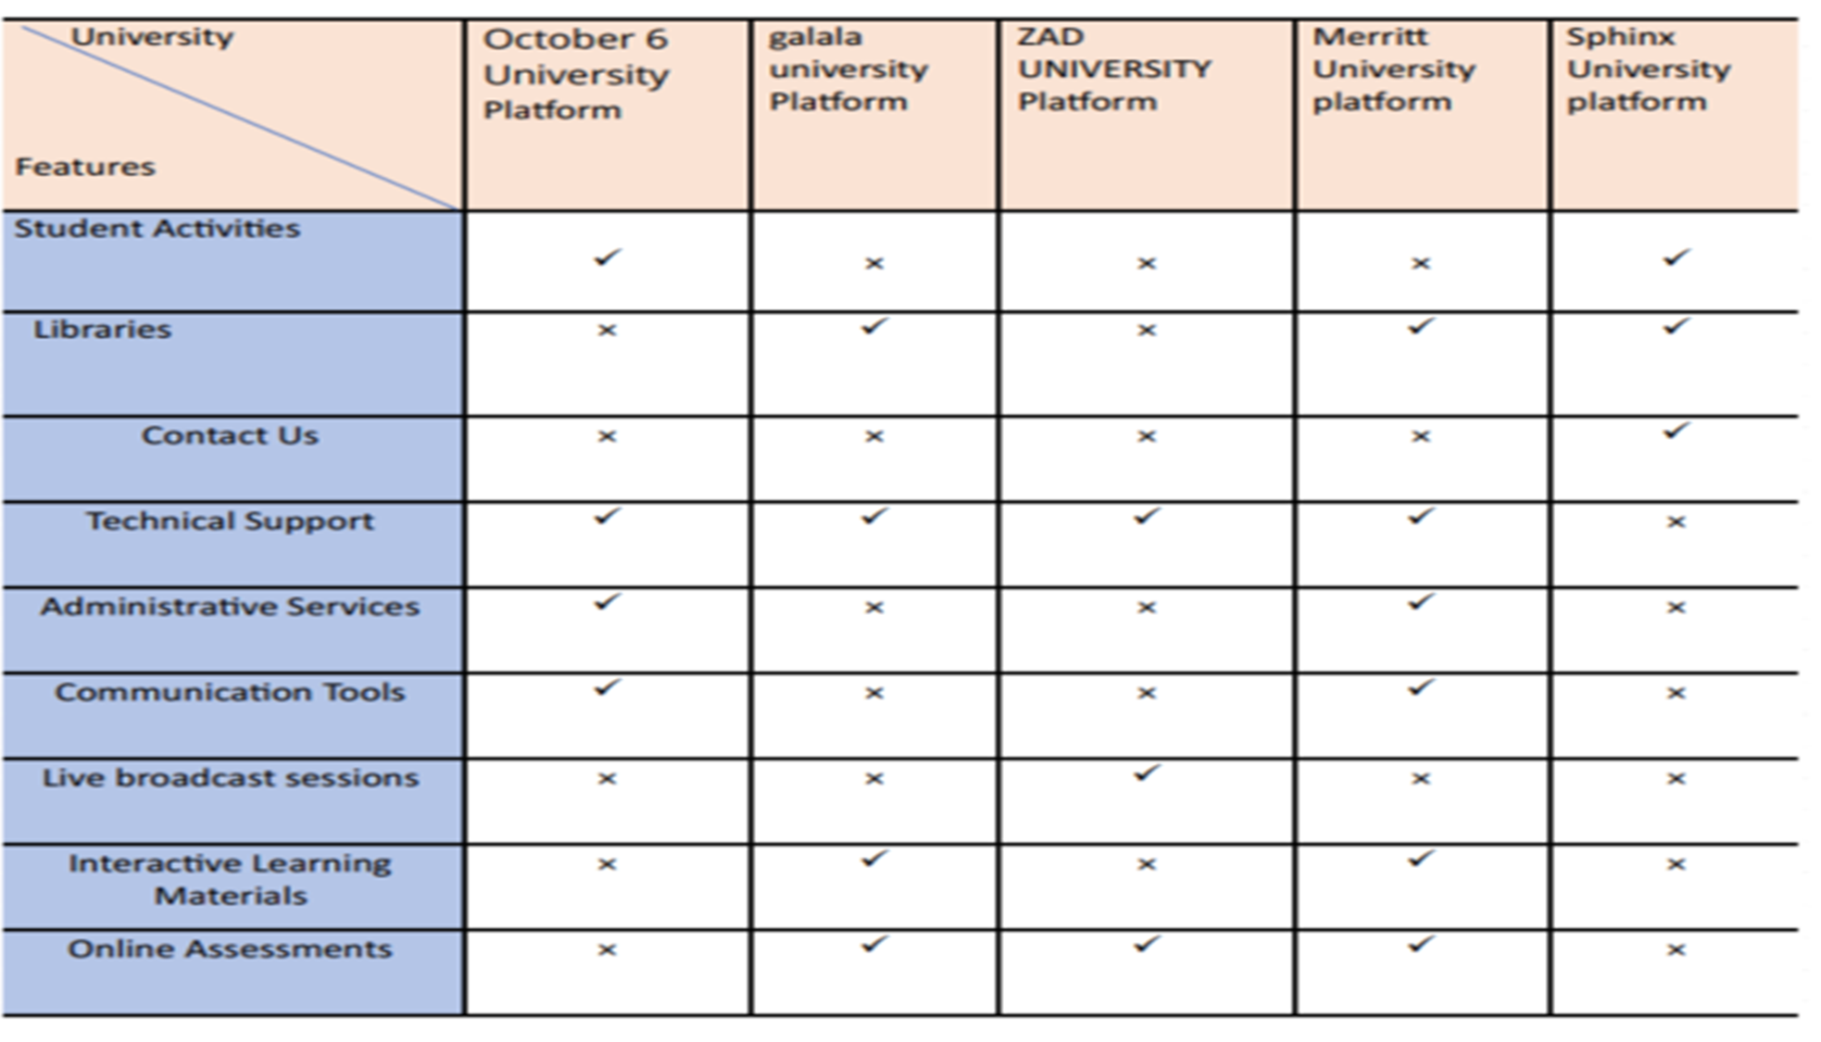

Slide 9
Egyptian National E-Learning University
3
System analysis and design
Sohag 2024

Slide 10
System analysis and design
Systems Analysis:
Systems Design
•This phase involves collecting and interpreting facts, identifying problems, and breaking down a system into its components. The goal is to understand the system’s objectives and improve its efficiency.
•During this stage, we plan a new business system or replace an existing one. We define its components or modules to meet specific requirements. Understanding the existing system thoroughly is crucial before embarking on the design process

Slide 11


Functional Requirements

Slide 12
Functional Requirements
Professer
Student Affairs
Student
•Add Material
•Add tasks and Quizzes
•Add Test bank
•add and Edits grades
•Add Courses
1.Add Post
2.Mange Courses
3.Mange Student data
4.Add Evaluation Form
1.Submits assignments and tasks
2.View grads
3.Download Material
4.Doing online quizzes
5.Fill in a questionnaire Form

Slide 13
NonFunctional Requirements

Slide 14
Non Functional Requirements
•Enhance user interface and user experience for a more intuitive and seamless evaluation process.
•Implement automated reminders and notifications to ensure timely completion of evaluations.

Slide 15
Non Functional Requirements
•Improve data security and privacy measures to protect sensitive student information.
•Conduct user research and feedback sessions to gather insights for further improvements.

Slide 16
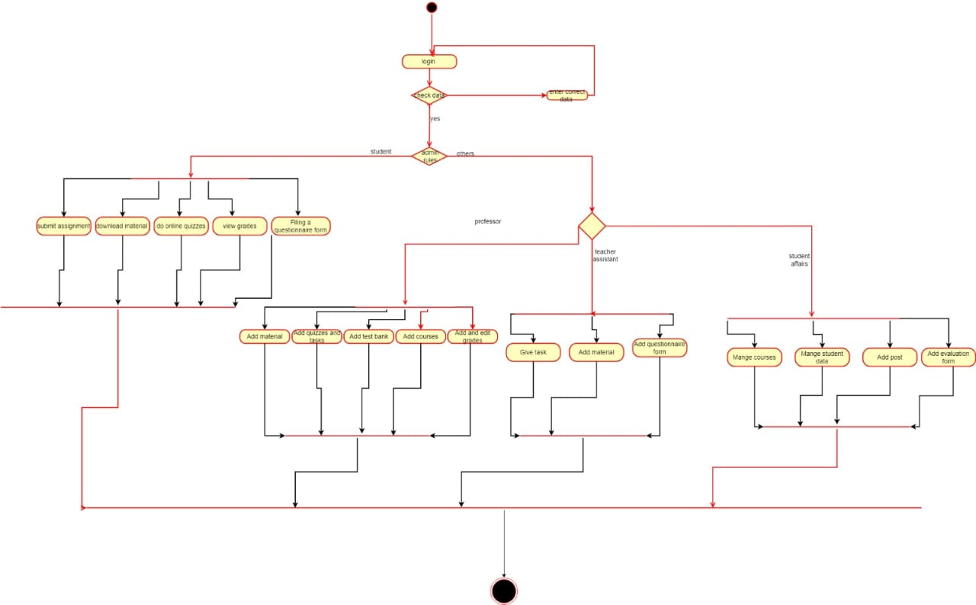

Slide 17
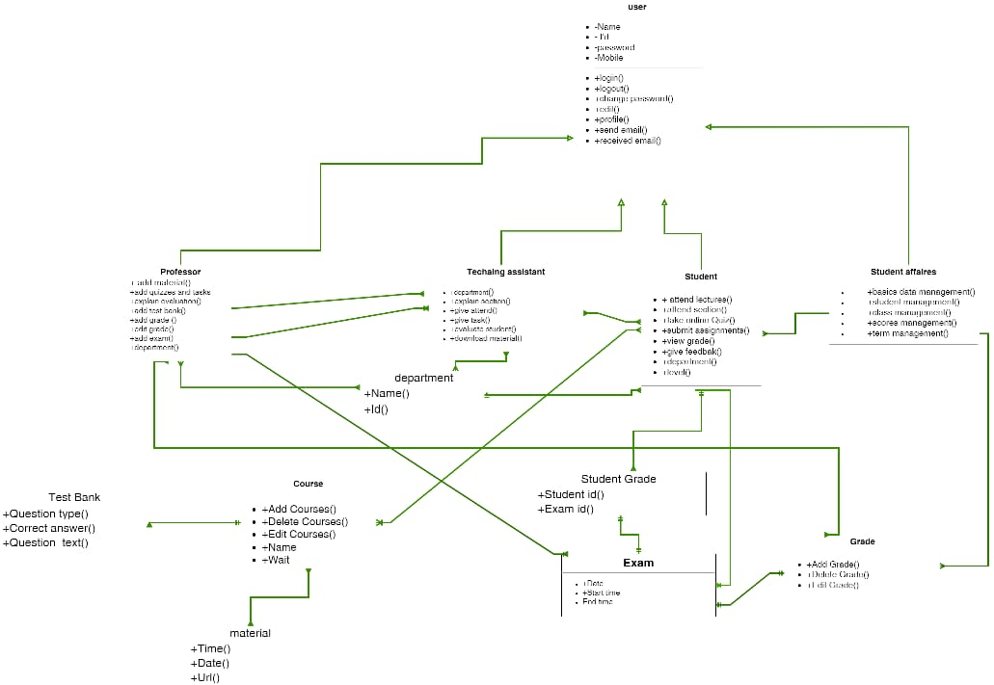

Slide 18
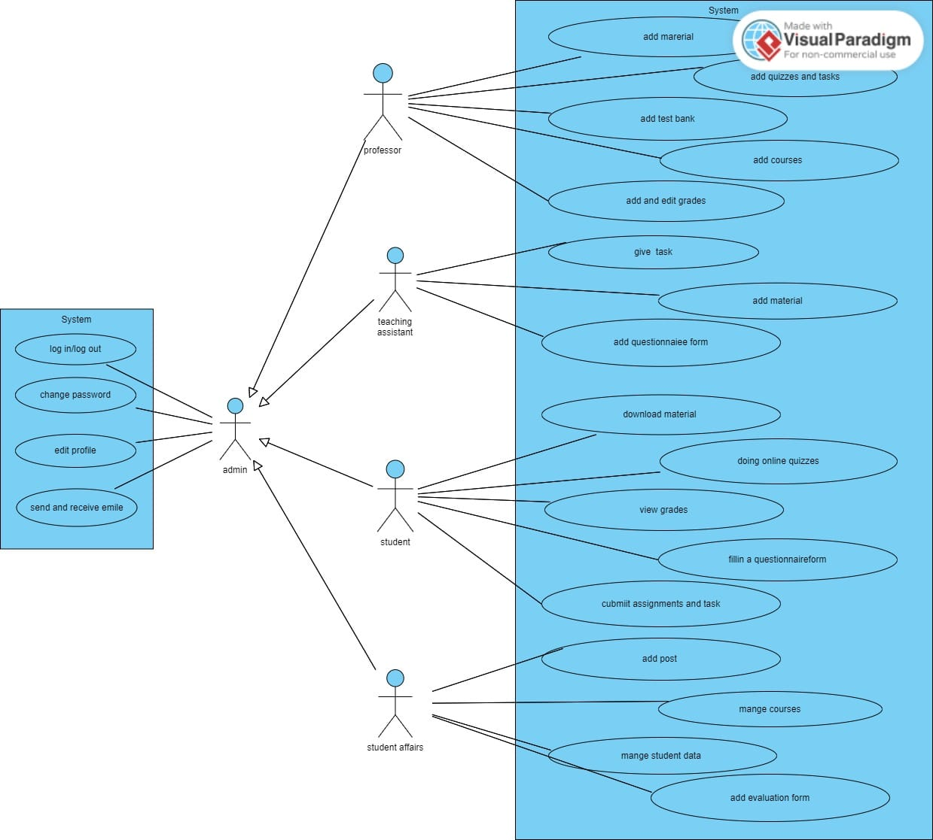

Slide 19
Egyptian National E-Learning University
4
Implementation
Sohag 2024

Slide 20



Tools Used
XMAPP
Visual Studio Code
Figma Design

Slide 21





Technologies Used
Java Script
CSS3
HTML5
PHP
MY SQL

Slide 22
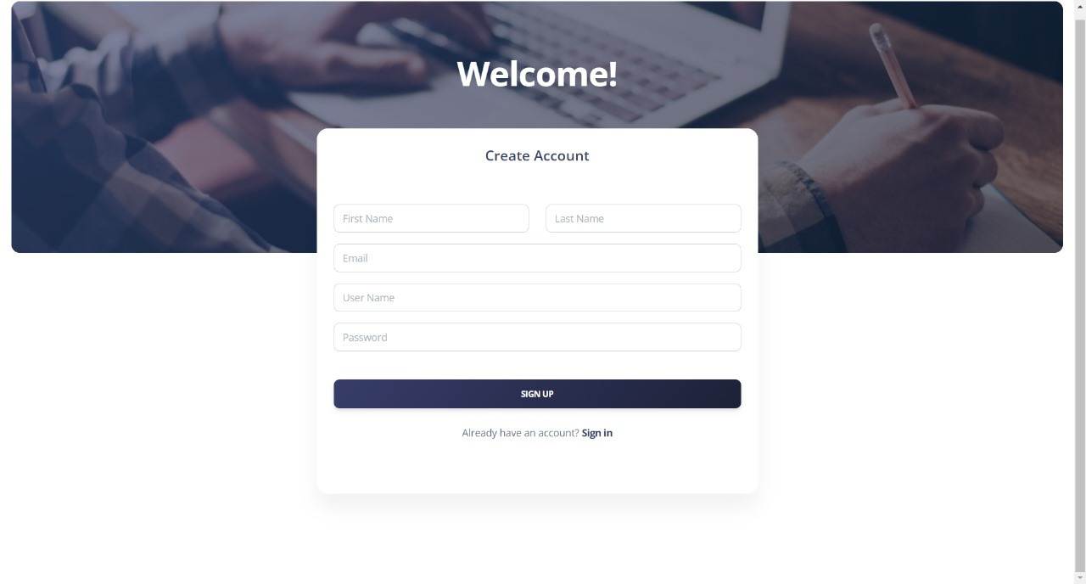
SignUp Page

Slide 23

Login Home

Slide 24
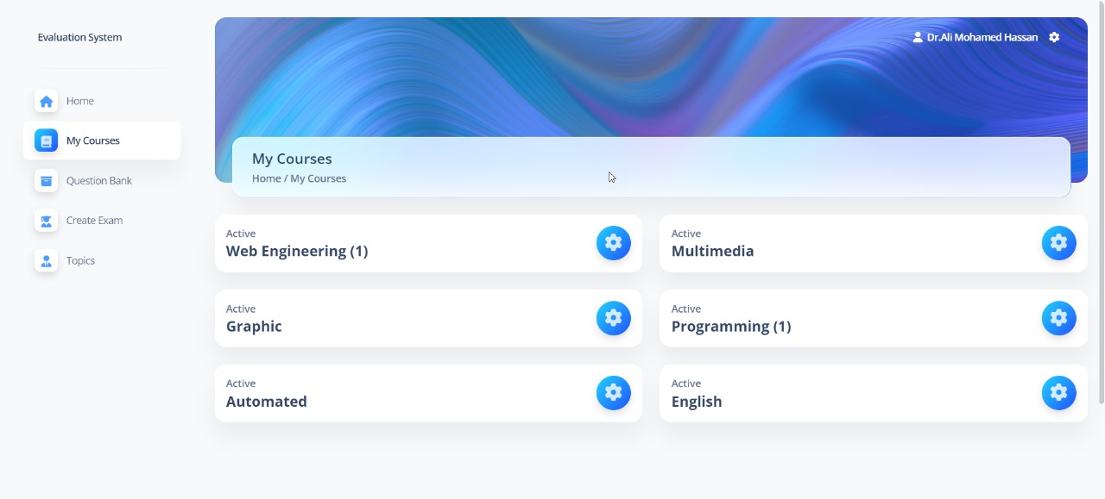
My Courses Page

Slide 25
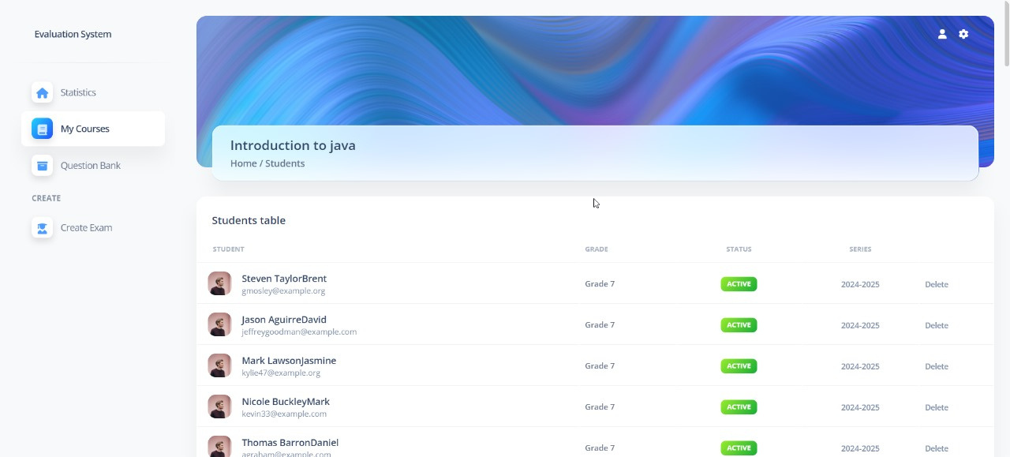
Home Student Page

Slide 26
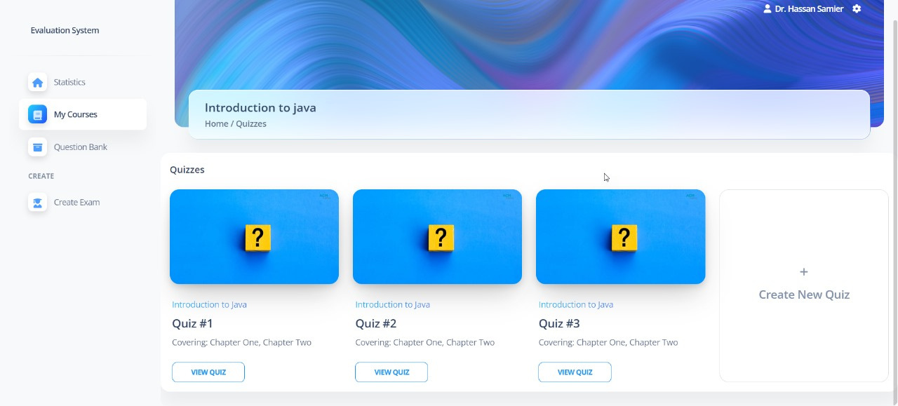
Home Quizzes Page

Slide 27
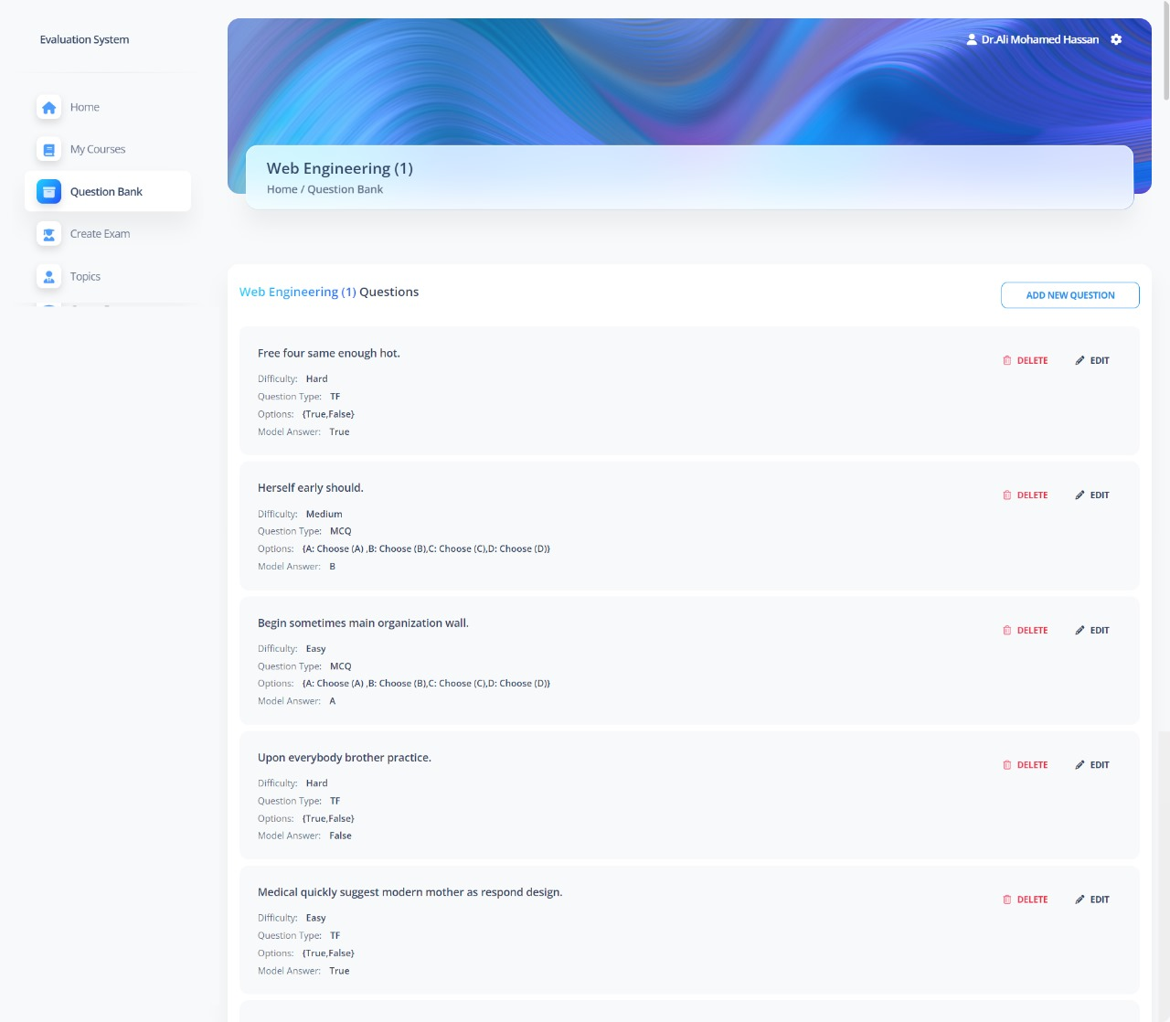
Questions BankPage

Slide 28
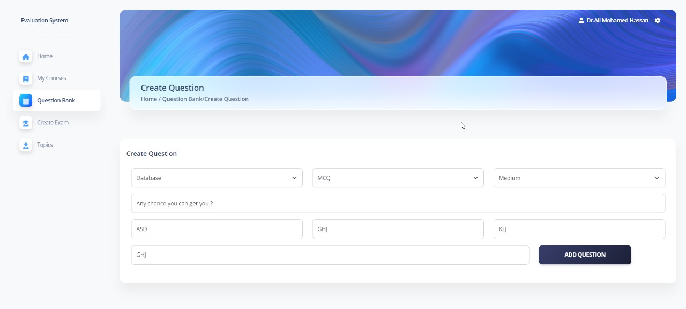
Create Question

Slide 29
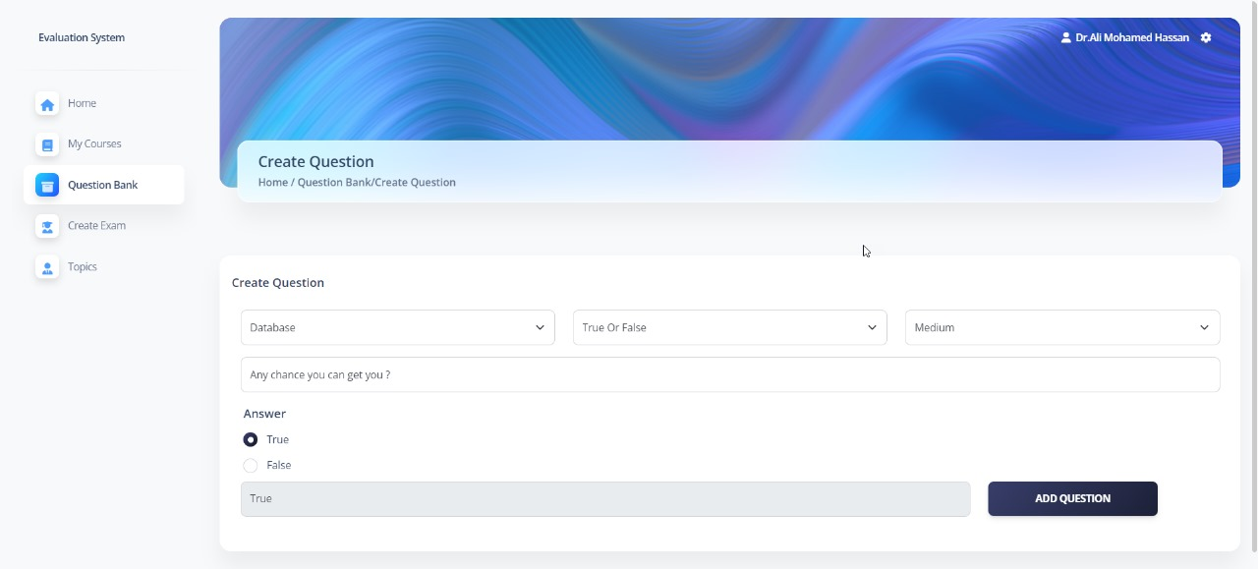
Create Question

Slide 30
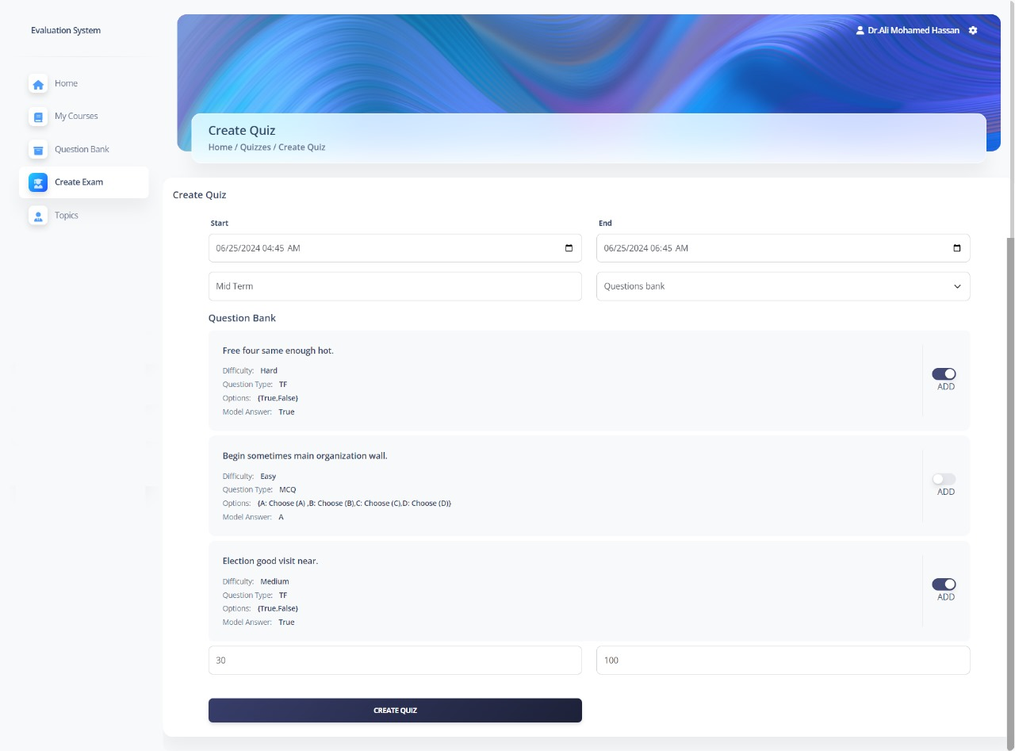
Create Exam Page

Slide 31
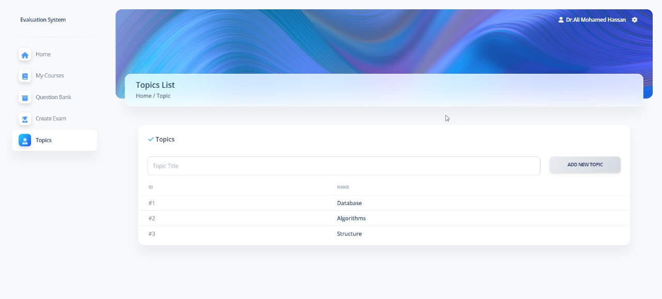
Topics Page

Slide 32

Demo Video
Let’s Stop
5 Minutes
To Present
Our Demo

Slide 33
Egyptian National E-Learning University
5
Future Work
Sohag 2024

Slide 34

Automated grading
AI can handle repetitive tasks like grading multiple-choice questions, freeing up instructors’ time for more in-depth evaluation.
Personalized insights
Personalized insights: AI can identify strengths and weaknesses in student projects, offering tailored feedback for improvement.

Slide 35
Egyptian National E-Learning University
6
Conclusion
Sohag 2024

Slide 36
Conclusion
In conclusion, the Evaluation System Student revolutionizes evaluation in education. By streamlining assessments and ensuring accuracy, fairness, and comprehensiveness, we empower educators to better understand and support their students. Let's continue advancing evaluation methods to create an educational environment where every student can thrive. Thank you.

Slide 37



Egyptian National E-Learning University
Thank You
Sohag 2024

